Slide 1
DIGITAL PORTFOLIO
STUDENT NAME: ASHOK KUMAR R
ROLL NO AND NMID:asanm10824131081802522015
DEPARMENT:COMPUTER SICENCE COLLEGE/UNIVERSITY:TKGAC/ANNAMALAI UNIVERSITY

Slide 2
PROJECT TITLE
TO CREATE A DIGITAL PORTFOLIO

Slide 3
AGENDA
PROBLEM STATEMENT
PROJECT OVERVIEW
END USERS
TOOLS AND TECNOLOGIES
FEATURES AND FUNTIONALITY
RESULTS AND SCREENSHOTS
SCREENSHOT
CONCLUSION

Slide 4
PROBLEM STATEMENT
LACK OF A STUCTURE DIGITAL PORTFOLIO PLATFORM FOR STUDENTS
LIMITED VISIBILITY TO RECRUITERS AND ACADEMIC EVALUATORS

Slide 5
PROJECT OVERVEIW
DEVELOPMENT FO A DIGITAL PORTFOLIO SYSTEM FOR STUDENTS
A PLATFORM THAT INTEGRATES ACADEMIC,PROJECT,AND SKILL-BASED ACHIEVEMENTS

Slide 6
END USERS
STUDENTS-TO SHOWCASE THEIR WORK AND SKILLS
RECRUITS/EMPLOYEE
PEERS/COLLABORATES

Slide 7
TOOLS AND TECNOLOGIES
FRONTEND:HTML,CSS,JAVASCRIPT,REACT
BACKEND:NODE.JS/FLAKS
DATABASE
VERSION CONTROL
DESIGN TOOL

Slide 8
FEATURES AND FUNTONS
USER AUTHENTICATION AND PROFILE MANAGEMENT
DYANMIC SKILL AND CERTIFICATION
SEARCH AND FILTER FOR RECRUITS

Slide 9
RESULTS ANS SCREENSHOTS
THE DIGITAL PORTFOLIO SUCCESSFULLY BUILD A RESPONSIVE SHOWCASE

Slide 10
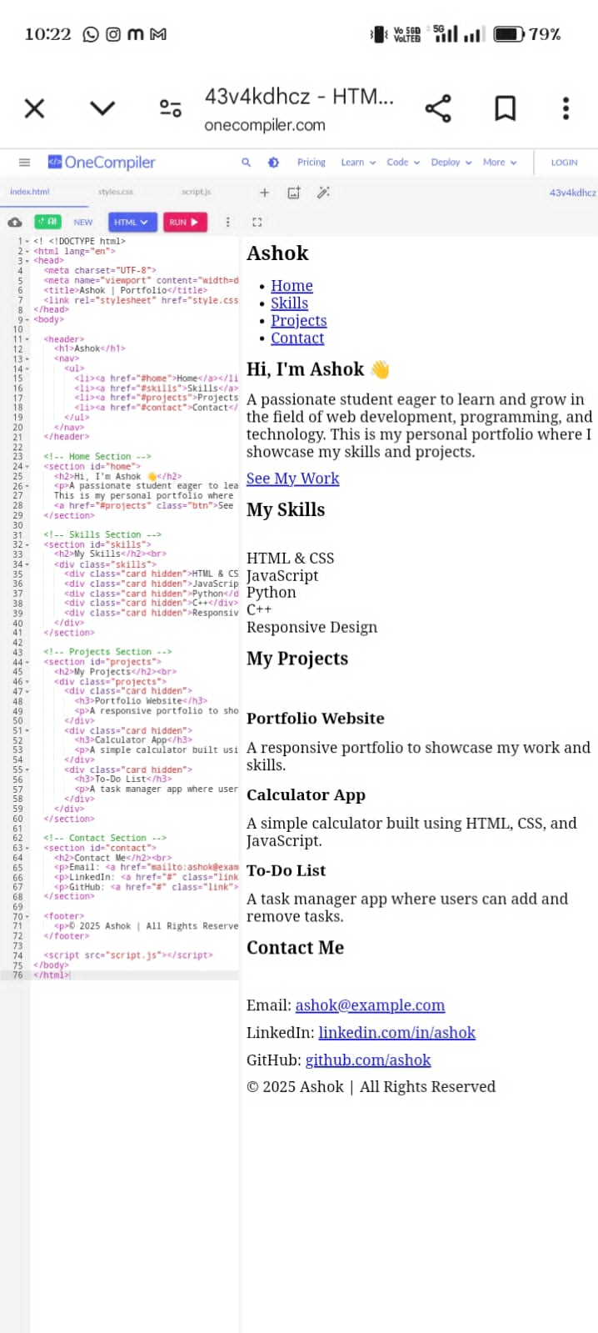
SCREENSHOT

Slide 11
CONLUSION
DIGITAL PORTFOLIO HELPS STUDENTS STAND OUT FROM TRADITIONAL RESUMES
PROVIDES RECRUITS WITH BETTER SKILLS.

